Slide 1
Mechanisms and Robotics DE CA ZG561
Lecture-10

Slide 2
Manipulator Jacobian
4 dof SCARA Manipulator
Manipulator Jacobian of a 4 axis SCARA
3 dof Polar Manipulator
Tool Configuration Jacobian
Manipulator Jacobian
5 dof Articulated Manipulator
Manipulator Jacobian

Slide 3
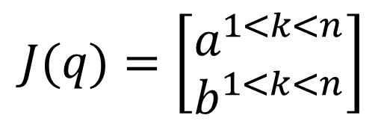
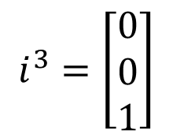
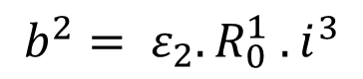
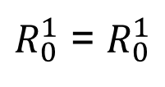
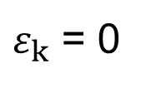
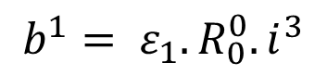
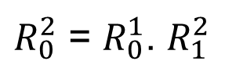
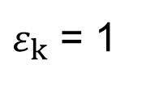
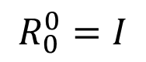
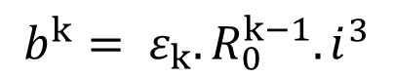
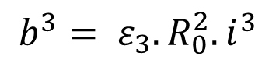
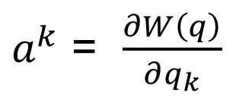
Algorithm for Finding the Manipulator Jacobian
$$J(q)=\left[\begin{matrix}a^{1<k<n} \\ b^{1<k<n}\end{matrix}\right]$$
$a^{k}$ = $\frac{∂W\left(q\right)}{∂q_{k}}$
$$b^{k}= ε_{k}. R_{0}^{k−1}. i^{3}$$
$$i^{3}=\left[\begin{matrix}0 \\ 0 \\ 1\end{matrix}\right]$$
$$b^{1}= ε_{1}. R_{0}^{0}. i^{3}$$
$$R_{0}^{0}=I$$
$$b^{2}= ε_{2}. R_{0}^{1} . i^{3}$$
$R_{0}^{1}$ = $R_{0}^{1}$
$ε_{k}$ = 1
Revolute Joint
$$b^{3}= ε_{3}. R_{0}^{2}. i^{3}$$
$R_{0}^{2}$ = $R_{0}^{1}$. $R_{1}^{2}$
$ε_{k}$ = 0
Prismatic Joint

Slide 4
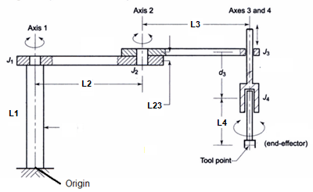
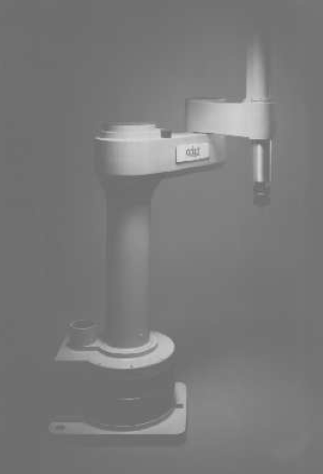
Tool Configuration Jacobian of a 4 axis SCARA

Slide 5
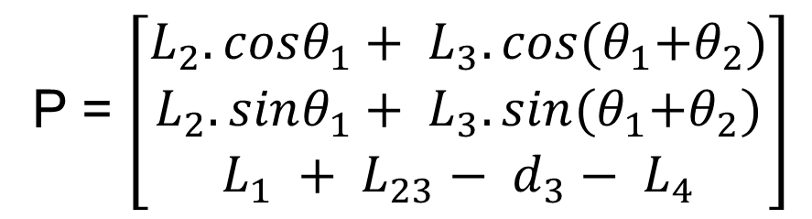
4 axis SCARA
P = $\left[\begin{matrix}L_{2}.cosθ_{1}+ L_{3}.cos{(θ}_{1}+θ_{2}) \\ L_{2}. sinθ_{1}+ L_{3}. sin{(θ}_{1}+θ_{2}) \\ L_{1} + L_{23}− d_{3}− L_{4}\end{matrix}\right]$

Slide 6
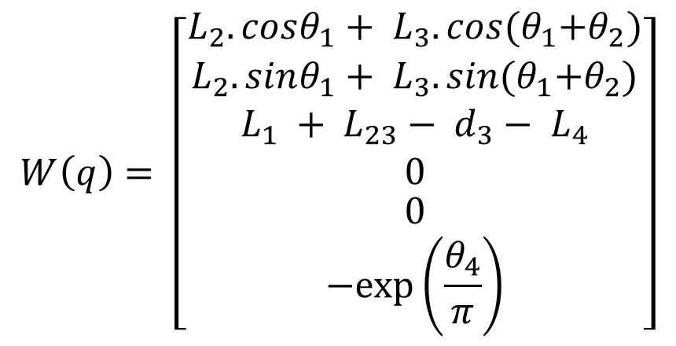
4 axis SCARA
$$W\left(q\right)= \left[\begin{matrix}L_{2}.cosθ_{1}+ L_{3}.cos{(θ}_{1}+θ_{2}) \\ \begin{matrix}L_{2}. sinθ_{1}+ L_{3}. sin{(θ}_{1}+θ_{2}) \\ L_{1} + L_{23}− d_{3}− L_{4} \\ 0\end{matrix} \\ \begin{matrix}0 \\ −exp⁡\left(\frac{θ_{4}}{π}\right)\end{matrix}\end{matrix}\right]$$

Slide 7
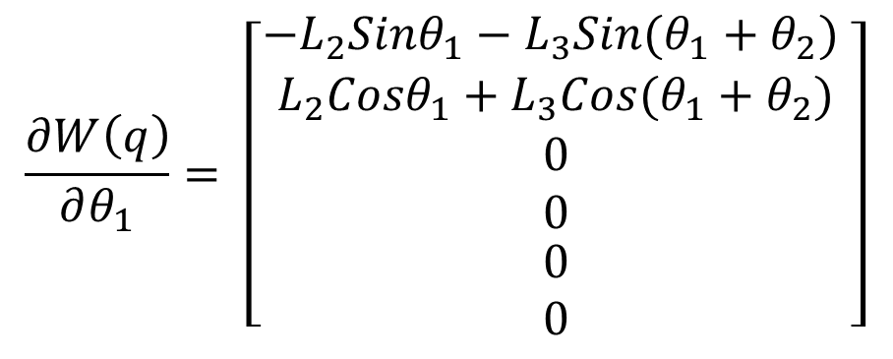
Finding the Tool Configuration Jacobian
$$\frac{∂W\left(q\right)}{∂θ_{1}}= \left[\begin{matrix}−L_{2}{Sinθ}_{1}−L_{3}{Sin(θ}_{1}+θ_{2}) \\ \begin{matrix}L_{2}{Cosθ}_{1}+L_{3}{Cos(θ}_{1}+θ_{2}) \\ 0 \\ 0\end{matrix} \\ \begin{matrix}0 \\ 0\end{matrix}\end{matrix}\right]$$

Slide 8
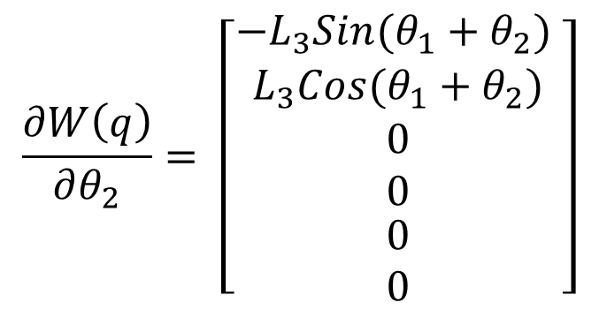
Finding the Tool Configuration Jacobian
$$\frac{∂W\left(q\right)}{∂θ_{2}}= \left[\begin{matrix}−L_{3}{Sin(θ}_{1}+θ_{2}) \\ \begin{matrix}L_{3}{Cos(θ}_{1}+θ_{2}) \\ 0 \\ 0\end{matrix} \\ \begin{matrix}0 \\ 0\end{matrix}\end{matrix}\right]$$

Slide 9
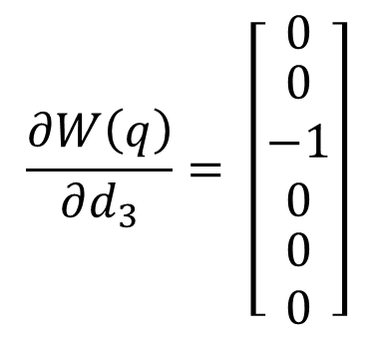
Finding the Tool Configuration Jacobian
$$\frac{∂W\left(q\right)}{∂d_{3}}= \left[\begin{matrix}0 \\ \begin{matrix}0 \\ −1 \\ 0\end{matrix} \\ \begin{matrix}0 \\ 0\end{matrix}\end{matrix}\right]$$

Slide 10
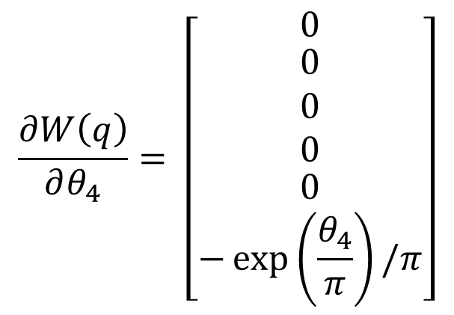
Finding the Tool Configuration Jacobian
$$\frac{∂W\left(q\right)}{∂θ_{4}}= \left[\begin{matrix}0 \\ \begin{matrix}0 \\ 0 \\ 0\end{matrix} \\ \begin{matrix}0 \\ −\exp\left(\frac{θ_{4}}{π}\right)/π\end{matrix}\end{matrix}\right]$$

Slide 11
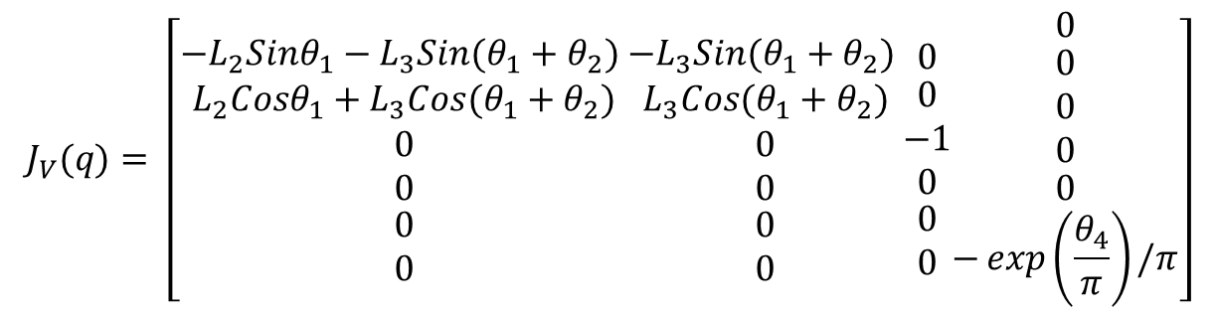
Tool Configuration Jacobian of a 4 dof SCARA
$$J_{V}(q)= \left[\begin{matrix}−L_{2}{Sinθ}_{1}−L_{3}{Sin(θ}_{1}+θ_{2}) \\ \begin{matrix}L_{2}{Cosθ}_{1}+L_{3}{Cos(θ}_{1}+θ_{2}) \\ 0 \\ 0\end{matrix} \\ \begin{matrix}0 \\ 0\end{matrix}\end{matrix}\begin{matrix}−L_{3}{Sin(θ}_{1}+θ_{2}) \\ \begin{matrix}L_{3}{Cos(θ}_{1}+θ_{2}) \\ 0 \\ 0\end{matrix} \\ \begin{matrix}0 \\ 0\end{matrix}\end{matrix}\begin{matrix}0 \\ \begin{matrix}0 \\ −1 \\ 0\end{matrix} \\ \begin{matrix}0 \\ 0\end{matrix}\end{matrix}\begin{matrix}0 \\ \begin{matrix}0 \\ 0 \\ 0\end{matrix} \\ \begin{matrix}0 \\ −\exp\left(\frac{θ_{4}}{π}\right)/π\end{matrix}\end{matrix}\right]$$

Slide 12
Algorithm for Finding the Manipulator Jacobian
$$J(q)=\left[\begin{matrix}a^{1<k<n} \\ b^{1<k<n}\end{matrix}\right]$$
$a^{k}$ = $\frac{∂W\left(q\right)}{∂q_{k}}$
$$b^{k}= ε_{k}. R_{0}^{k−1}. i^{3}$$
$$i^{3}=\left[\begin{matrix}0 \\ 0 \\ 1\end{matrix}\right]$$
$$b^{1}= ε_{1}. R_{0}^{0}. i^{3}$$
$$R_{0}^{0}=I$$
$$b^{2}= ε_{2}. R_{0}^{1} . i^{3}$$
$R_{0}^{1}$ = $R_{0}^{1}$
$ε_{k}$ = 1
Revolute Joint
$$b^{3}= ε_{3}. R_{0}^{2}. i^{3}$$
$R_{0}^{2}$ = $R_{0}^{1}$. $R_{1}^{2}$
$ε_{k}$ = 0
Prismatic Joint

Slide 13
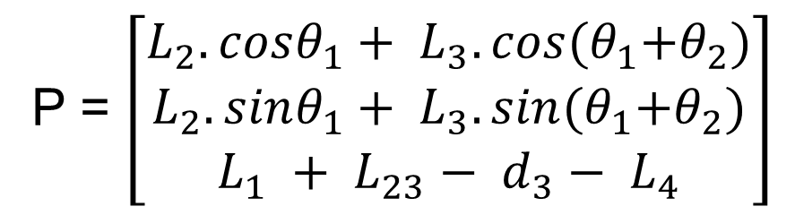
P = $\left[\begin{matrix}L_{2}.cosθ_{1}+ L_{3}.cos{(θ}_{1}+θ_{2}) \\ L_{2}. sinθ_{1}+ L_{3}. sin{(θ}_{1}+θ_{2}) \\ L_{1} + L_{23}− d_{3}− L_{4}\end{matrix}\right]$

Slide 15
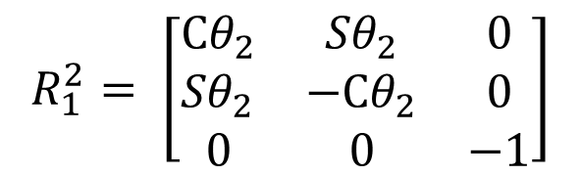
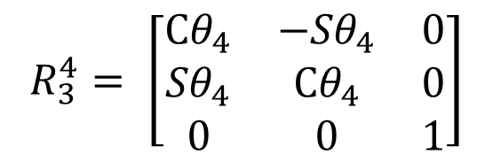
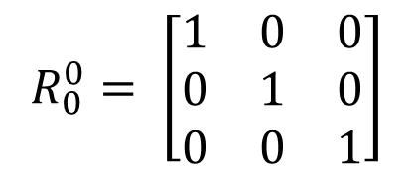
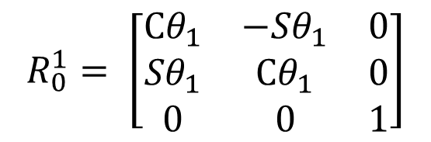
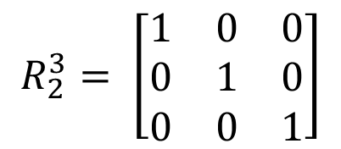
Manipulator Jacobian of a 4 axis SCARA
$$R_{0}^{0}= \left[\begin{matrix}1 & 0 & 0 \\ 0 & 1 & 0 \\ 0 & 0 & 1\end{matrix}\right]$$
$$R_{3}^{4}= \left[\begin{matrix}{Cθ}_{4} & {−Sθ}_{4} & 0 \\ {Sθ}_{4} & {Cθ}_{4} & 0 \\ 0 & 0 & 1\end{matrix}\right]$$
$$R_{0}^{1}= \left[\begin{matrix}{Cθ}_{1} & {−Sθ}_{1} & 0 \\ {Sθ}_{1} & {Cθ}_{1} & 0 \\ 0 & 0 & 1\end{matrix}\right]$$
$$R_{1}^{2}= \left[\begin{matrix}{Cθ}_{2} & {Sθ}_{2} & 0 \\ {Sθ}_{2} & {−Cθ}_{2} & 0 \\ 0 & 0 & −1\end{matrix}\right]$$
$$R_{2}^{3}= \left[\begin{matrix}1 & 0 & 0 \\ 0 & 1 & 0 \\ 0 & 0 & 1\end{matrix}\right]$$

Slide 17
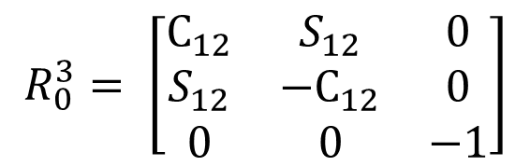
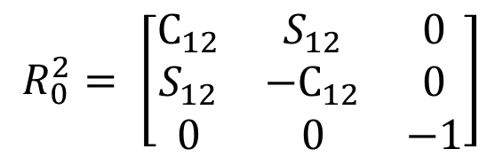
$$R_{0}^{2}= \left[\begin{matrix}C_{12} & S_{12} & 0 \\ S_{12} & −C_{12} & 0 \\ 0 & 0 & −1\end{matrix}\right]$$
$$R_{0}^{3}= \left[\begin{matrix}C_{12} & S_{12} & 0 \\ S_{12} & −C_{12} & 0 \\ 0 & 0 & −1\end{matrix}\right]$$

Slide 18
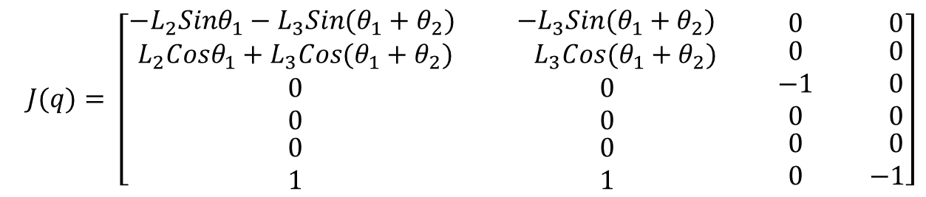
Manipulator Jacobian of a 4 axis SCARA
$$J(q)= \left[\begin{matrix}−L_{2}{Sinθ}_{1}−L_{3}{Sin(θ}_{1}+θ_{2}) \\ \begin{matrix}L_{2}{Cosθ}_{1}+L_{3}{Cos(θ}_{1}+θ_{2}) \\ 0 \\ 0\end{matrix} \\ \begin{matrix}0 \\ 1\end{matrix}\end{matrix}\begin{matrix} −L_{3}{Sin(θ}_{1}+θ_{2}) \\ \begin{matrix}{ L}_{3}{Cos(θ}_{1}+θ_{2}) \\ 0 \\ 0\end{matrix} \\ \begin{matrix} 0 \\ 1\end{matrix}\end{matrix}\begin{matrix} 0 \\ \begin{matrix} 0 \\ −1 \\ 0\end{matrix} \\ \begin{matrix} 0 \\ 0\end{matrix}\end{matrix}\begin{matrix} 0 \\ \begin{matrix} 0 \\ 0 \\ 0\end{matrix} \\ \begin{matrix} 0 \\ −1\end{matrix}\end{matrix}\right]$$

Slide 19
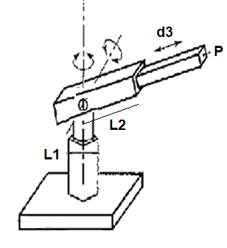
3 dof Polar Arm

Slide 20
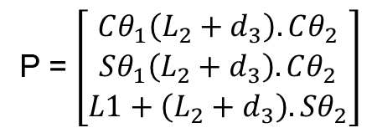
3 dof Polar Arm
P = $\left[\begin{matrix}Cθ_{1}\left(L_{2}+d_{3}\right).Cθ_{2} \\ Sθ_{1}\left(L_{2}+d_{3}\right).Cθ_{2} \\ L1+\left(L_{2}+d_{3}\right).Sθ_{2}\end{matrix}\right]$

Slide 21
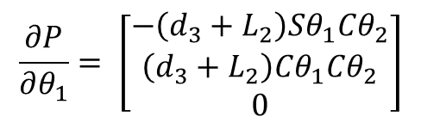
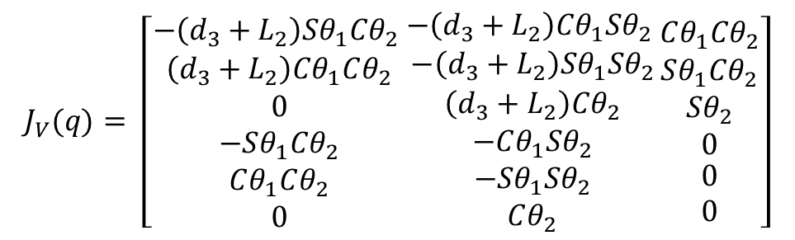
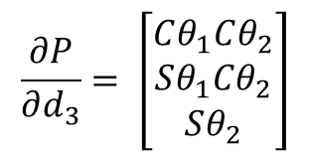
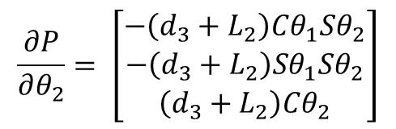
3 dof Polar Arm
P = $\left[\begin{matrix}Cθ_{1}\left(L_{2}+d_{3}\right).Cθ_{2} \\ Sθ_{1}\left(L_{2}+d_{3}\right).Cθ_{2} \\ L1+\left(L_{2}+d_{3}\right).Sθ_{2}\end{matrix}\right]$
$$\frac{∂P}{∂θ_{1}}= \left[\begin{matrix}−\left(d_{3}+L_{2}\right)Sθ_{1}Cθ_{2} \\ \left(d_{3}+L_{2}\right)Cθ_{1}Cθ_{2} \\ 0\end{matrix}\right]$$
$$\frac{∂P}{∂d_{3}}= \left[\begin{matrix}Cθ_{1}Cθ_{2} \\ Sθ_{1}Cθ_{2} \\ Sθ_{2}\end{matrix}\right]$$
$$\frac{∂P}{∂θ_{2}}= \left[\begin{matrix}−\left(d_{3}+L_{2}\right)Cθ_{1}Sθ_{2} \\ −\left(d_{3}+L_{2}\right)Sθ_{1}Sθ_{2} \\ \left(d_{3}+L_{2}\right)Cθ_{2}\end{matrix}\right]$$
Tool Configuration Jacobian
$$J_{V}(q)= \left[\begin{matrix}−\left(d_{3}+L_{2}\right)Sθ_{1}Cθ_{2} \\ \begin{matrix}\left(d_{3}+L_{2}\right)Cθ_{1}Cθ_{2} \\ 0 \\ −Sθ_{1}Cθ_{2}\end{matrix} \\ \begin{matrix}Cθ_{1}Cθ_{2} \\ 0\end{matrix}\end{matrix}\begin{matrix}−\left(d_{3}+L_{2}\right)Cθ_{1}Sθ_{2} \\ \begin{matrix}−\left(d_{3}+L_{2}\right)Sθ_{1}Sθ_{2} \\ \left(d_{3}+L_{2}\right)Cθ_{2} \\ −Cθ_{1}Sθ_{2}\end{matrix} \\ \begin{matrix}−Sθ_{1}Sθ_{2} \\ Cθ_{2}\end{matrix}\end{matrix}\begin{matrix}Cθ_{1}Cθ_{2} \\ \begin{matrix}Sθ_{1}Cθ_{2} \\ Sθ_{2} \\ 0\end{matrix} \\ \begin{matrix}0 \\ 0\end{matrix}\end{matrix}\right]$$

Slide 22
Algorithm for Finding the Manipulator Jacobian
$$J(q)=\left[\begin{matrix}a^{1<k<n} \\ b^{1<k<n}\end{matrix}\right]$$
$a^{k}$ = $\frac{∂W\left(q\right)}{∂q_{k}}$
$$b^{k}= ε_{k}. R_{0}^{k−1}. i^{3}$$
$$i^{3}=\left[\begin{matrix}0 \\ 0 \\ 1\end{matrix}\right]$$
$$b^{1}= ε_{1}. R_{0}^{0}. i^{3}$$
$$R_{0}^{0}=I$$
$$b^{2}= ε_{2}. R_{0}^{1} . i^{3}$$
$R_{0}^{1}$ = $R_{0}^{1}$
$ε_{k}$ = 1
Revolute Joint
$$b^{3}= ε_{3}. R_{0}^{2}. i^{3}$$
$R_{0}^{2}$ = $R_{0}^{1}$. $R_{1}^{2}$
$ε_{k}$ = 0
Prismatic Joint

Slide 24
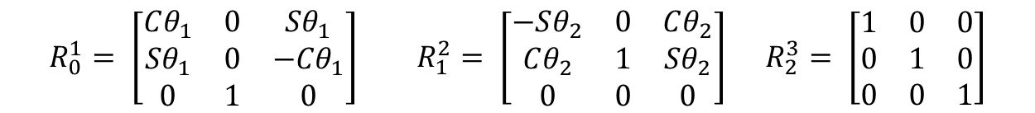
3 dof Polar Arm
$$R_{0}^{1}= \left[\begin{matrix}Cθ_{1} & 0 & Sθ_{1} \\ {Sθ}_{1} & 0 & {−Cθ}_{1} \\ 0 & 1 & 0\end{matrix}\right] R_{1}^{2}= \left[\begin{matrix}−Sθ_{2} & 0 & Cθ_{2} \\ Cθ_{2} & 1 & Sθ_{2} \\ 0 & 0 & 0\end{matrix}\right] R_{2}^{3}= \left[\begin{matrix}1 & 0 & 0 \\ 0 & 1 & 0 \\ 0 & 0 & 1\end{matrix}\right]$$

Slide 25
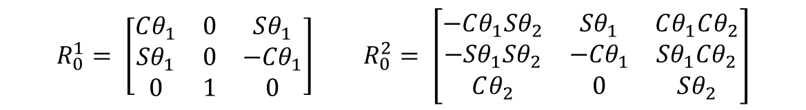
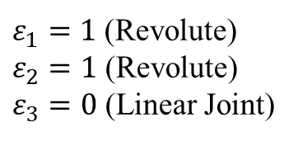
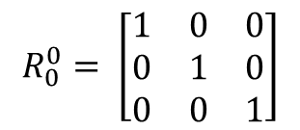
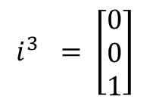
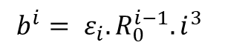
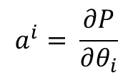
3 dof Polar Arm
$$R_{0}^{0}= \left[\begin{matrix}1 & 0 & 0 \\ 0 & 1 & 0 \\ 0 & 0 & 1\end{matrix}\right]$$
$$R_{0}^{1}= \left[\begin{matrix}Cθ_{1} & 0 & Sθ_{1} \\ {Sθ}_{1} & 0 & {−Cθ}_{1} \\ 0 & 1 & 0\end{matrix}\right] R_{0}^{2}= \left[\begin{matrix}−Cθ_{1}Sθ_{2} & Sθ_{1} & Cθ_{1}Cθ_{2} \\ −{Sθ}_{1}Sθ_{2} & {−Cθ}_{1} & {Sθ}_{1}Cθ_{2} \\ Cθ_{2} & 0 & Sθ_{2}\end{matrix}\right]$$
$$a^{i}= \frac{∂P}{∂θ_{i}}$$
$$b^{i}= ε_{i}. R_{0}^{i−1}.i^{3}$$
$$i^{3} = \left[\begin{matrix}0 \\ 0 \\ 1\end{matrix}\right]$$
$ε_{1}=1$ (Revolute)
$ε_{2}=1$ (Revolute)
$ε_{3}=0$ (Linear Joint)

Slide 26
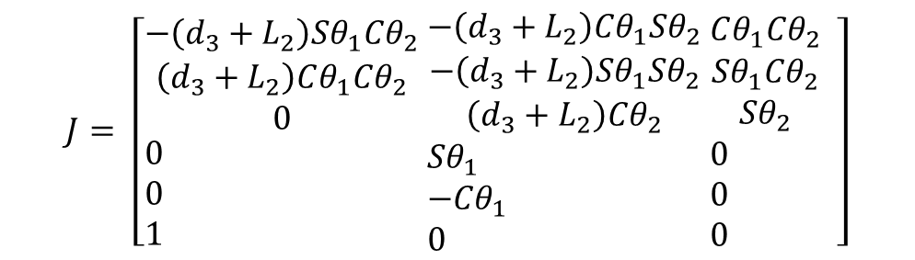
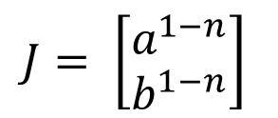
3 dof Polar Arm
$$J= \left[\begin{matrix}a^{1−n} \\ b^{1−n}\end{matrix}\right]$$
Manipulator Jacobian
$$J= \left[\begin{aligned}&\begin{matrix}−\left(d_{3}+L_{2}\right)Sθ_{1}Cθ_{2} \\ \left(d_{3}+L_{2}\right)Cθ_{1}Cθ_{2} \\ 0\end{matrix} \\ &0 \\ &0 \\ &1\end{aligned} \begin{aligned}&\begin{matrix}−\left(d_{3}+L_{2}\right)Cθ_{1}Sθ_{2} \\ −\left(d_{3}+L_{2}\right)Sθ_{1}Sθ_{2} \\ \left(d_{3}+L_{2}\right)Cθ_{2}\end{matrix} \\ &Sθ_{1} \\ &{−Cθ}_{1} \\ &0\end{aligned} \begin{aligned}&\begin{matrix}Cθ_{1}Cθ_{2} \\ Sθ_{1}Cθ_{2} \\ Sθ_{2}\end{matrix} \\ &0 \\ &0 \\ &0\end{aligned} \right]$$

Slide 27
5 dof manipulator - Manipulator Jacobian

Slide 28
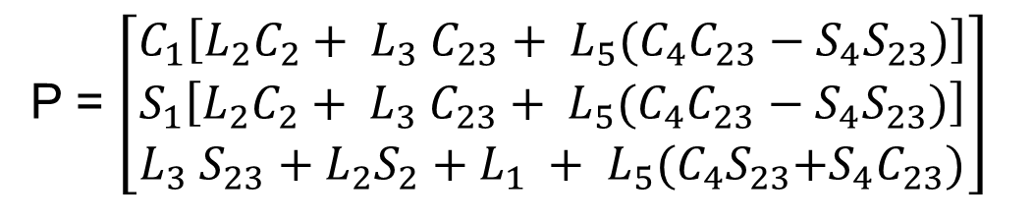
P = $\left[\begin{matrix}C_{1}\left[L_{2}C_{2}+ L_{3} C_{23}+ L_{5}(C_{4}C_{23}−S_{4}S_{23})\right] \\ S_{1}\left[L_{2}C_{2}+ L_{3} C_{23}+ L_{5}(C_{4}C_{23}−S_{4}S_{23})\right] \\ {L_{3} S_{23}+L_{2}S_{2}+L}_{1} + L_{5}{(C_{4}S}_{23}+S_{4}C_{23})\end{matrix}\right]$

Slide 29
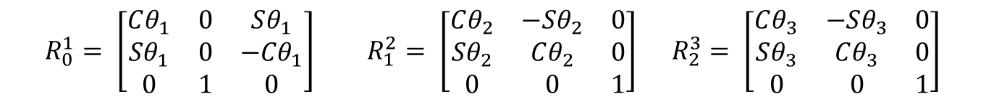

P = $\left[\begin{matrix}C_{1}\left[L_{2}C_{2}+ L_{3} C_{23}+ L_{5}(C_{4}C_{23}−S_{4}S_{23})\right] \\ S_{1}\left[L_{2}C_{2}+ L_{3} C_{23}+ L_{5}(C_{4}C_{23}−S_{4}S_{23})\right] \\ {L_{3} S_{23}+L_{2}S_{2}+L}_{1} + L_{5}{(C_{4}S}_{23}+S_{4}C_{23})\end{matrix}\right]$
$$R_{0}^{1}= \left[\begin{matrix}Cθ_{1} & 0 & Sθ_{1} \\ {Sθ}_{1} & 0 & {−Cθ}_{1} \\ 0 & 1 & 0\end{matrix}\right] R_{1}^{2}= \left[\begin{matrix}Cθ_{2} & −Sθ_{2} & 0 \\ Sθ_{2} & Cθ_{2} & 0 \\ 0 & 0 & 1\end{matrix}\right] R_{2}^{3}= \left[\begin{matrix}Cθ_{3} & −Sθ_{3} & 0 \\ Sθ_{3} & Cθ_{3} & 0 \\ 0 & 0 & 1\end{matrix}\right]$$
$$R_{3}^{4}= \left[\begin{matrix}0 & −Sθ_{4} & Cθ_{4} \\ 0 & Cθ_{4} & Sθ_{4} \\ −1 & 0 & 0\end{matrix}\right] R_{4}^{5}= \left[\begin{matrix}Cθ_{5} & −Sθ_{5} & 0 \\ Sθ_{5} & Cθ_{5} & 0 \\ 0 & 0 & 1\end{matrix}\right]$$

Slide 31
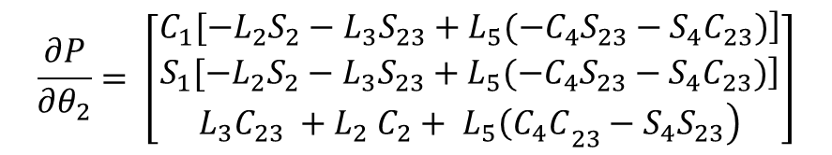
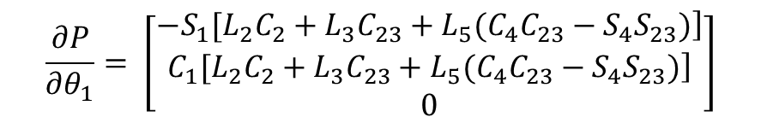
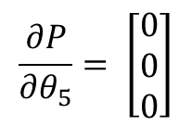


$$\frac{∂P}{∂θ_{1}}= \left[\begin{matrix}\left.{−S}_{1}[L_{2}C_{2}+L_{3}C_{23}+L_{5}(C_{4}C_{23}−S_{4}S_{23})\right] \\ \left.C_{1}[L_{2}C_{2}+L_{3}C_{23}+L_{5}(C_{4}C_{23}−S_{4}S_{23})\right] \\ 0\end{matrix}\right]$$
$$\frac{∂P}{∂θ_{2}}= \left[\begin{matrix}\left.C_{1}[−L_{2}S_{2}−L_{3}S_{23}+L_{5}({−C}_{4}S_{23}−S_{4}C_{23})\right] \\ \left.S_{1}[−L_{2}S_{2}−L_{3}S_{23}+L_{5}({−C}_{4}S_{23}−S_{4}C_{23})\right] \\ \left.{L_{3}C}_{23} {+ L}_{2}C_{2}+ L_{5}{\left(C_{4}C\right.}_{23}−S_{4}S_{23}\right)\end{matrix}\right]$$
$$\frac{∂P}{∂θ_{3}}= \left[\begin{matrix}\left.C_{1}[{−L}_{3}S_{23}−L_{5}(C_{4}S_{23}+S_{4}C_{23})\right] \\ \left.S_{1}[−L_{2}S_{23}−L_{5}(C_{4}S_{23}+S_{4}C_{23})\right] \\ \left.{L_{3}C}_{23} + L_{5}{\left(C_{4}C\right.}_{23}−S_{4}S_{23}\right)\end{matrix}\right]$$
$$\frac{∂P}{∂θ_{4}}= \left[\begin{matrix}\left.{−C}_{1}[L_{5}(S_{4}C_{23}+C_{4}S_{23})\right] \\ \left.{−S}_{1}[L_{5}(S_{4}C_{23}+C_{4}S_{23})\right] \\ \left. L_{5}{\left({−S}_{4}S\right.}_{23}+C_{4}C_{23}\right)\end{matrix}\right]$$
$$\frac{∂P}{∂θ_{5}}= \left[\begin{matrix}0 \\ 0 \\ 0\end{matrix}\right]$$

Slide 32








$$R_{0}^{4}= \left[\begin{matrix}−Sθ_{1} & −Cθ_{1}Sθ_{234} & Cθ_{1}Cθ_{234} \\ {Cθ}_{1} & −Sθ_{1}Sθ_{234} & {Sθ}_{1}Cθ_{234} \\ 0 & Cθ_{234} & Sθ_{234}\end{matrix}\right]$$
$$R_{0}^{0}= \left[\begin{matrix}1 & 0 & 0 \\ 0 & 1 & 0 \\ 0 & 0 & 1\end{matrix}\right]$$
$$a^{i}= \frac{∂P}{∂θ_{i}}$$
$$R_{0}^{1}= \left[\begin{matrix}Cθ_{1} & 0 & Sθ_{1} \\ {Sθ}_{1} & 0 & {−Cθ}_{1} \\ 0 & 1 & 0\end{matrix}\right]$$
$$b^{i}= ε. R_{0}^{i}.i^{3}$$
$$R_{0}^{2}= \left[\begin{matrix}Cθ_{1}Cθ_{2} & −Cθ_{1}Sθ_{2} & Sθ_{1} \\ {Sθ}_{1}Cθ_{2} & −Sθ_{1}Sθ_{2} & {−Cθ}_{1} \\ Sθ_{2} & Cθ_{2} & 0\end{matrix}\right]$$
$$J= \left[\begin{matrix}a^{1−n} \\ b^{1−n}\end{matrix}\right]$$
$$R_{0}^{3}= \left[\begin{matrix}Cθ_{1}Cθ_{23} & −Cθ_{1}Sθ_{23} & Sθ_{1} \\ {Sθ}_{1}Cθ_{23} & −Sθ_{1}Sθ_{23} & {−Cθ}_{1} \\ Sθ_{23} & Cθ_{23} & 0\end{matrix}\right]$$

Slide 34

5 dof manipulator - Manipulator Jacobian
$$J= \left[\begin{aligned}&\begin{matrix}\left.{−S}_{1}[L_{2}C_{2}+L_{3}C_{23}+L_{5}(C_{4}C_{23}−S_{4}S_{23})\right] \\ \left.C_{1}[L_{2}C_{2}+L_{3}C_{23}+L_{5}(C_{4}C_{23}−S_{4}S_{23})\right] \\ 0\end{matrix} \\ &0 \\ &0 \\ &1\end{aligned} \begin{aligned}&\begin{matrix}\left.C_{1}[−L_{2}S_{2}−L_{3}S_{23}+L_{5}({−C}_{4}S_{23}−S_{4}C_{23})\right] \\ \left.S_{1}[−L_{2}S_{2}−L_{3}S_{23}+L_{5}({−C}_{4}S_{23}−S_{4}C_{23})\right] \\ \left.{L_{3}C}_{23} {+ L}_{2}C_{2}+ L_{5}{\left(C_{4}C\right.}_{23}−S_{4}S_{23}\right)\end{matrix} \\ &Sθ_{1} \\ &{−Cθ}_{1} \\ &0\end{aligned} \begin{aligned}&\begin{matrix}\left.C_{1}[{−L}_{3}S_{23}−L_{5}(C_{4}S_{23}+S_{4}C_{23})\right] \\ \left.S_{1}[−L_{2}S_{23}−L_{5}(C_{4}S_{23}+S_{4}C_{23})\right] \\ \left.{L_{3}C}_{23} + L_{5}{\left(C_{4}C\right.}_{23}−S_{4}S_{23}\right)\end{matrix} \\ &Sθ_{1} \\ &{−Cθ}_{1} \\ &0\end{aligned} \begin{aligned}&\begin{matrix}\left.{−C}_{1}[L_{5}(S_{4}C_{23}+C_{4}S_{23})\right] \\ \left.{−S}_{1}[L_{5}(S_{4}C_{23}+C_{4}S_{23})\right] \\ \left. L_{5}{\left({−S}_{4}S\right.}_{23}+C_{4}C_{23}\right)\end{matrix} \\ &Sθ_{1} \\ &{−Cθ}_{1} \\ &0\end{aligned} \begin{aligned}&\begin{matrix}0 \\ 0 \\ 0\end{matrix} \\ &Cθ_{1}Cθ_{234} \\ &{Sθ}_{1}Cθ_{234} \\ &Sθ_{234}\end{aligned}\right]$$

Slide 35
THANK YOU
The presenter is grateful to the authors of the following text books for their wonderful work.
Fundamentals of Robotics – Robert Schilling
Industrial Robotics Wesley Snyder

